Slide 1
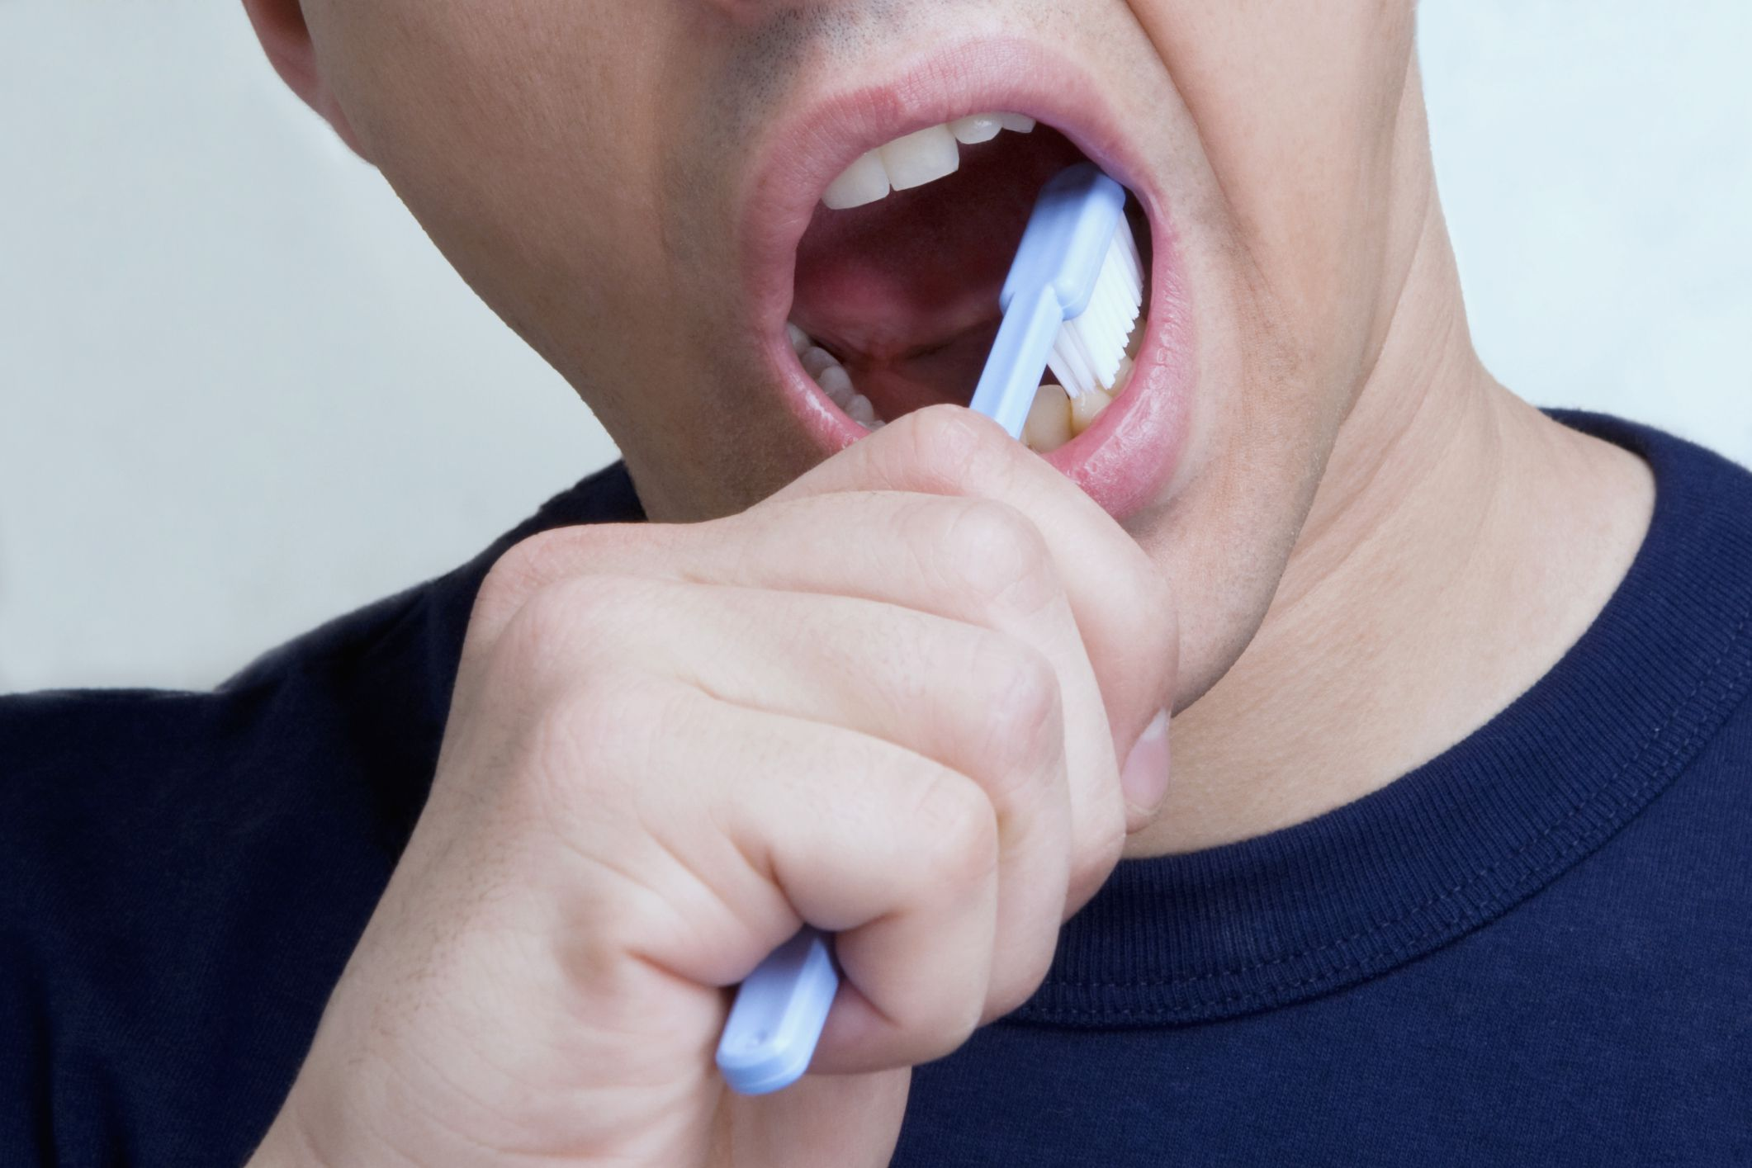
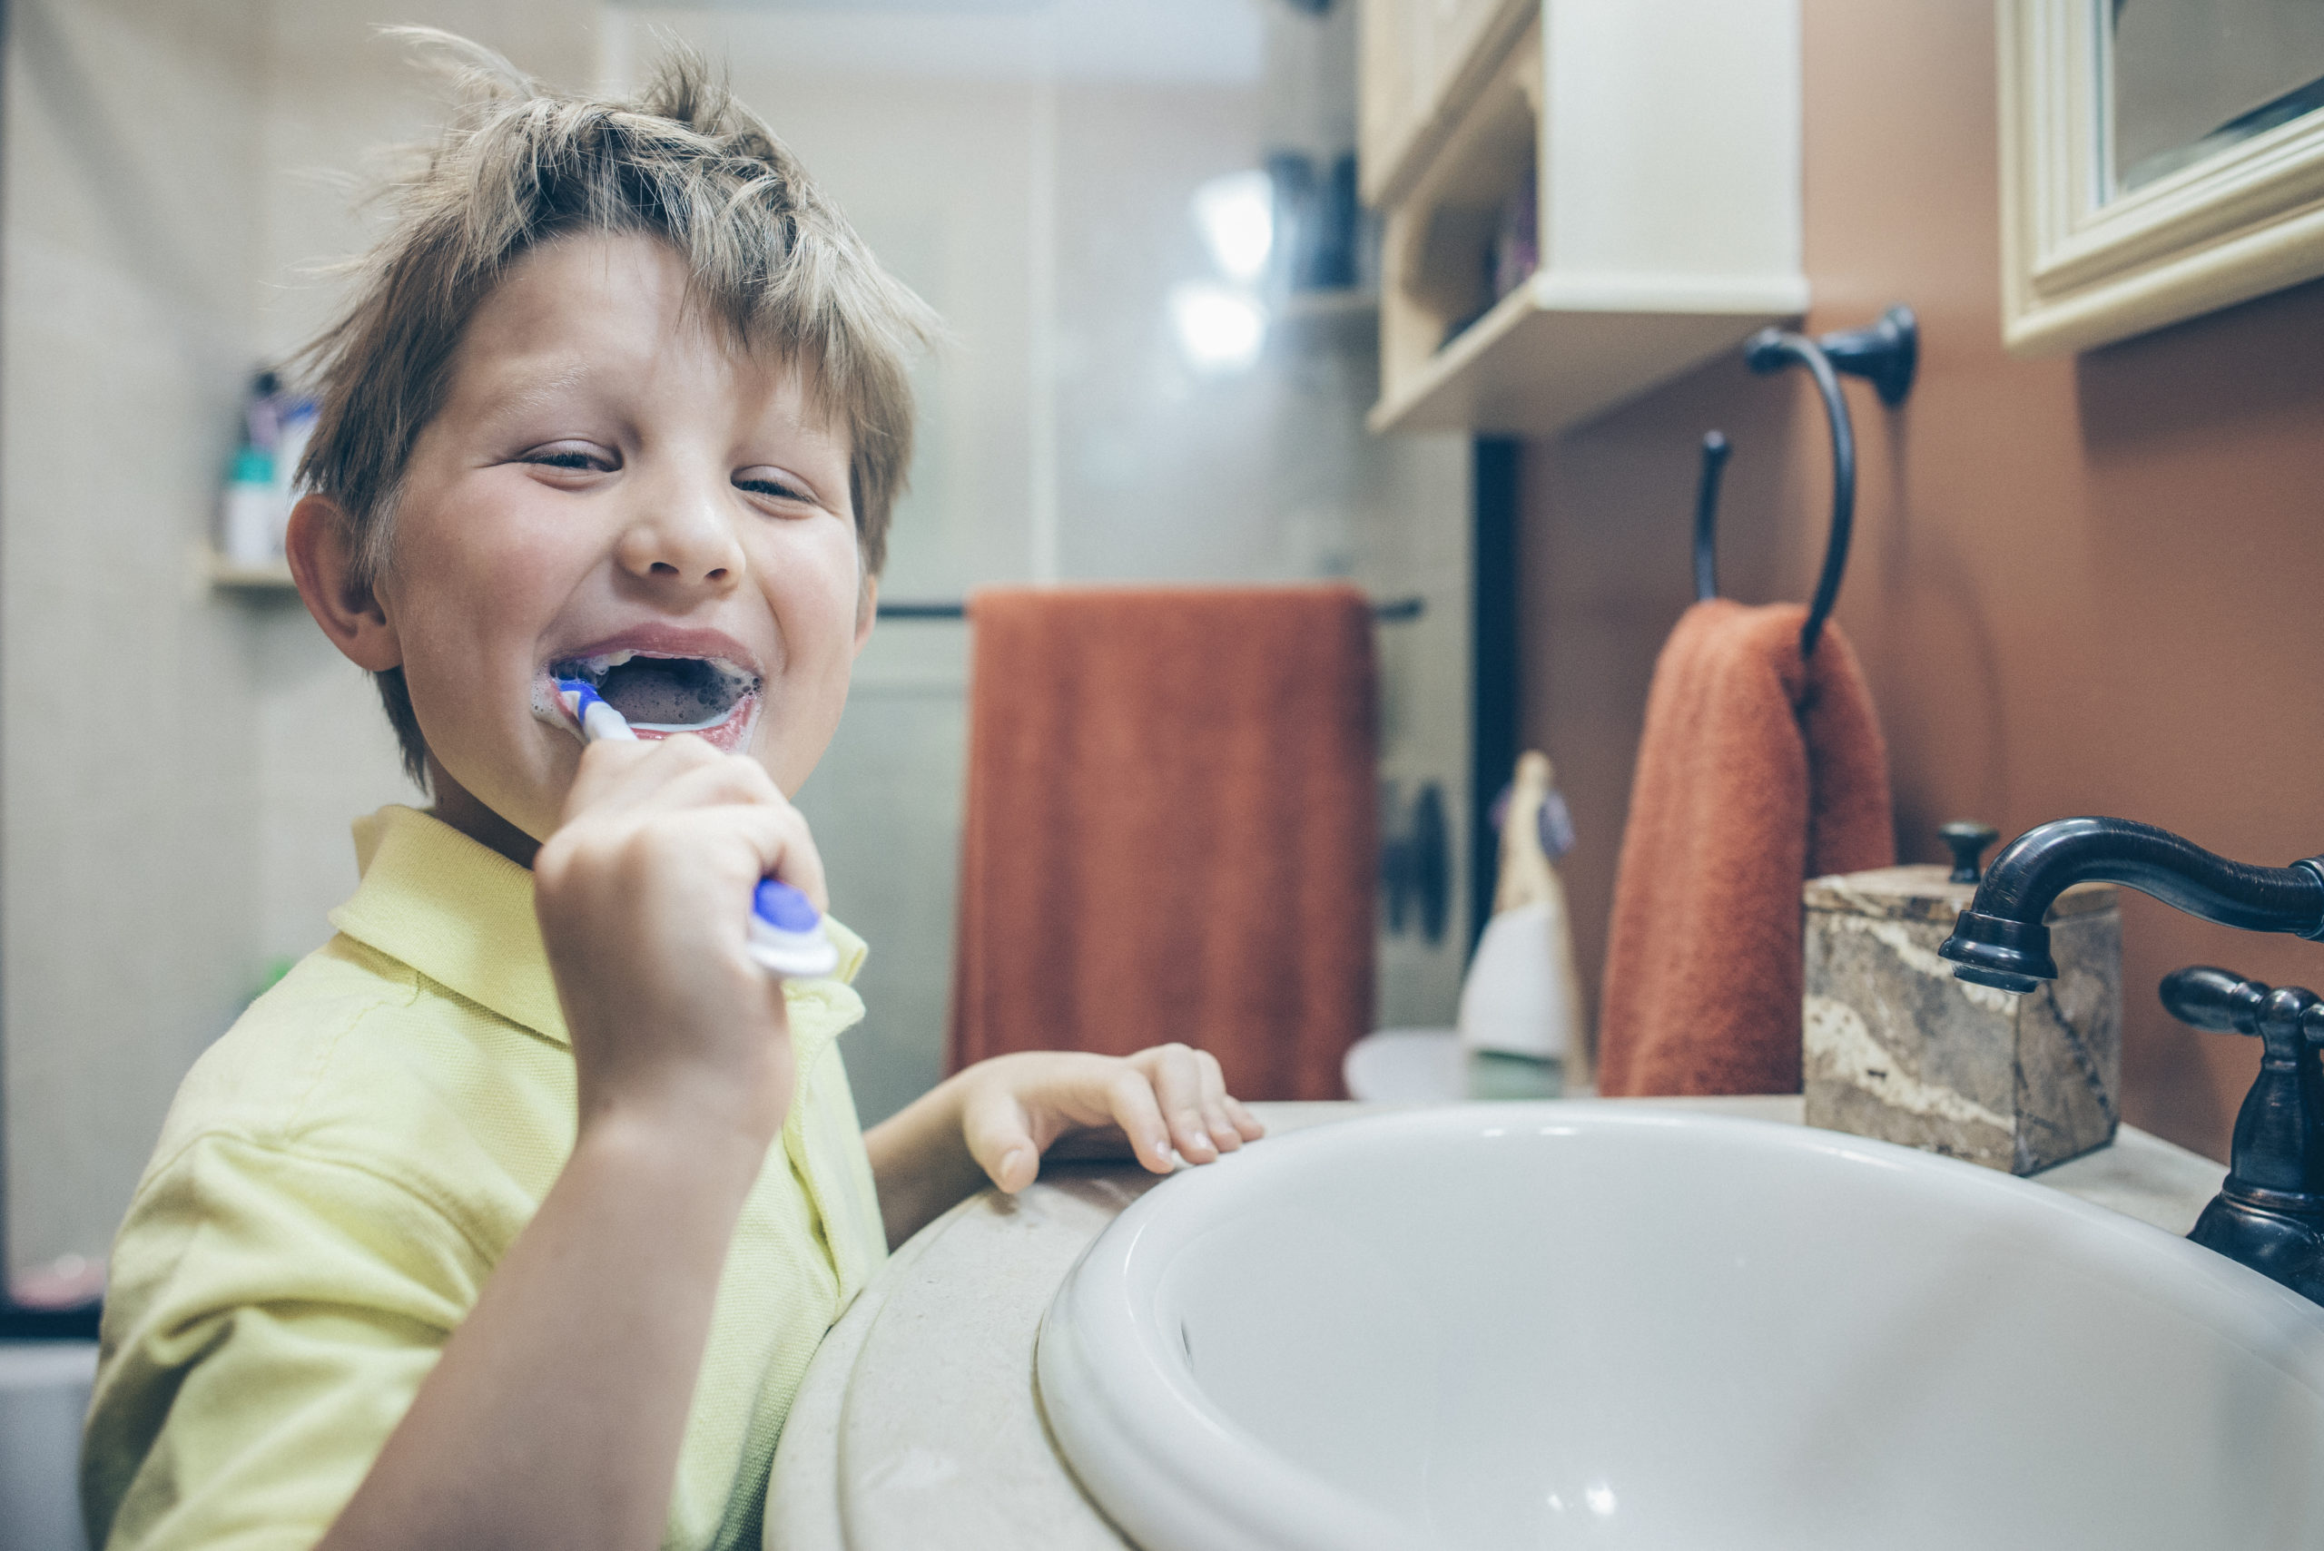
Do Now
Write down a set of instructions you would give to someone if you had to teach them to brush their teeth

Slide 2
Scientific Method
Success Criteria
I can describe the steps of the scientific method
I can create a method for a real-world experiment

Slide 3
I can describe the steps of the scientific method
When we last looked at what science is, we said that there were a series of steps we have to follow. This is called the scientific method.
Make an observation
Create a theory to explain the observation
Make a prediction on what will happen
Perform an experiment to test the prediction

Slide 4
I can describe the steps of the scientific method
What happens after the experiment depends on how the experiment went.
Perform an experiment to test the prediction
Experiment result matches the prediction
Experiment result does not match the prediction
The theory might be correct.
The theory is wrong and must be changed.

Slide 5
I can describe the steps of the scientific method
The scientific method can be summarised in a lot of different ways, however the most basic follows this flowchart:
The observations and theory crafting still happen, but they can happen in any order before predicting.
Predict what will happen
Perform an experiment to see if you’re right
Make a conclusion about the prediction

Slide 6

I can describe the steps of the scientific method
All basic experiments will usually be formally written up, and have the following sections:
Aim, or what you are trying to learn
Hypothesis, or what you think is going to happen
Method, a set of instructions you followed
Results, a table or graph describing what happened in the experiment
Discussion, a paragraph explaining the results
Conclusion, a summary of the experiment
We will go over all of these over the next few weeks

Slide 7
I can describe the steps of the scientific method
Which of the following is the correct sequence for this part of the scientific method:
Predicting → experimenting → concluding
Experimenting → predicting → concluding
Experimenting → concluding → predicting
Predicting → concluding → experimenting

Slide 8
I can describe the steps of the scientific method
Which of the following is the correct sequence for this part of the scientific method:
Predicting → experimenting → concluding
Experimenting → predicting → concluding
Experimenting → concluding → predicting
Predicting → concluding → experimenting

Slide 9
I can describe the steps of the scientific method
Which is not something you would include in an experimental write-up?
Aim
Hypothesis
Complication
Discussion

Slide 10
I can describe the steps of the scientific method
Which is not something you would include in an experimental write-up?
Aim
Hypothesis
Complication
Discussion

Slide 11
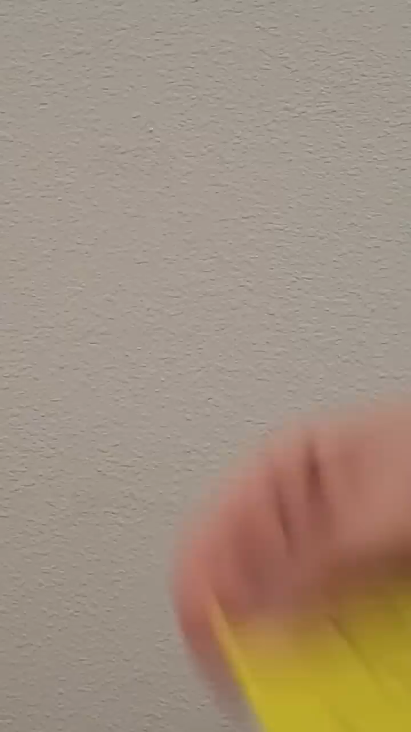
Brain Break
In this video, two of the facts shown are true, and the other is false. See if you can identify which is which before the end!
Notes:
https://www.youtube.com/shorts/hKpDK6PvwCA f video doesn’t work

Slide 12
I can create a method for a real-world experiment
Earlier, you all wrote methods detailing how to brush your teeth.
Now, you’re going to teach me how to brush my teeth.

Slide 13
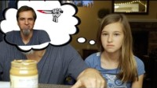
I can create a method for a real-world experiment
Notes:
https://youtu.be/cDA3_5982h8?t=37 if video doesn’t work. Play until after both kids first attempt

Slide 14
I can create a method for a real-world experiment
Whenever writing a method, we need to be clear and concise. Otherwise, people might end up doing things you would not expect!
Looking at your own instructions, see if you can figure out how you would improve the method you wrote.

Slide 15
I can create a method for a real-world experiment
Notes:
https://www.youtube.com/watch?v=cDA3_5982h8&t=331s if video doesn’t work. Play until after both kids first attempt

Slide 16
I can create a method for a real-world experiment
Tips to writing a good method:
Keep it clear and concise
Everything should be written in past tense
Make it step-by-step, in order of how you did it!
The video was about writing a set of instructions something will follow. A method is a set of instructions that someone has followed.

Slide 17

Brain Break
In this video, two of the facts shown are true, and the other is false. See if you can identify which is which before the end!
Notes:
https://www.youtube.com/shorts/bJtDC3zbvRo if video doesn’t work

Slide 18
Fertiliser effect on plants
Task
A very common experiment is to see the effect fertiliser has on plant growth. One student has come up with the following method:
"Plant the seeds in the soil with fertilizer. Water them regularly and observe the changes."
Your task is to note down the issues with this experimental design, and then re-write it.

Slide 19
I can create a method for a real-world experiment
Tips to writing a good method:
Keep it clear and concise
Everything should be written in past tense
Make it step-by-step, in order of how you did it!
A method is a set of instructions that someone has followed, which is why it needs to be in the past tense.

Slide 20
Scientific Method
It is extremely important that we write good methods so that experiments can be repeated.
Sometimes, experiments do weird things. If we are ever unsure about an experiment, then we need to repeat that experiment to see if the same thing happens again. If it does, then that means what happened was real and can be trusted.
If an experiment gives the same result when the method is repeated, we call it a reliable experiment. Reliability is particularly important for the social sciences, like psychology.

Slide 21
Scientific Method
Success Criteria
I can describe the steps of the scientific method
I can create a method for a real-world experiment

